Slide 1
Capstone Project-2
Machine Learning-Regression
Yes Bank Stock Closing Price Prediction Done by: Shadab Husain

Slide 2
Introduction:
Yes Bank Limited is an Indian private sector bank headquartered in Mumbai, India and was started by Rana Kapoor and Ashok Kapur in 2004.
It offers wide range of distinguished products for corporate and retail customers through retail banking and asset management services.
On 5 March 2020, in an attempt to avoid the failure of the bank, which had an excessive amount of bad loans, the Reserve Bank of India (RBI) took control of it.

Slide 3
Introduction(continue…)
We have been Provided with a dataset of the monthly Stock Price of Yes Bank .
The data has been provided from July 2005 till November 2020.
The bank has been making headline due to recent default.
We analysed the dataset and worked on predicting the stock closing price for the bank using other given parameter.

Slide 4
Problem statement
Yes Bank is a well-known bank in the Indian financial domain. Since 2018, it has been in the news because of the fraud case involving Rana Kapoor.
Owing to this fact, it was interesting to see how that impacted the stock prices of the company and whether Time series models or any other predictive models can do justice to such situations and to predict the closing values of the stocks.
The main objective is to predict the stock’s closing price of the month.

Slide 5
Knowing the Dataset
In this dataset, we have been provided with data which consists of total 5 columns and 185 rows of variables including ‘Date’, ‘Open’, ‘High’, ‘Low’, ‘Close’.
● ‘Date’ variable provides the time period of data which is dated from month of July
2005 to November 2020.
● ‘Open’ is the price at which the financial security opens in the market when trading
begins.
● ‘High’ is the highest price at which a stock trades over the course of a trading session.

Slide 6
Knowing the Dataset (continue…)
● ‘Low’ is the lowest price at which a stock trades over the course of a trading session.
● ‘Close’ is the last price at which a stock trades during a regular trading session.

Slide 7
Data Wrangling
Data Wrangling was carried out on given dataset which involved the process of cleaning, organizing, structuring, and enriching the raw data to make it more useful for analysis and visualization purposes. During this process we changed the format and data type of date feature into datetime.

Slide 8
Data Cleaning
We analysed the dataset for duplicate values, null values, missing values and it was observed the the data showed absence of any such data which means that there were no duplicate, missing or null values present in the given dataset.

Slide 9
Import libraries
Numpy
Pandas
Matplotlib
Seaborn
Sklearn

Slide 10
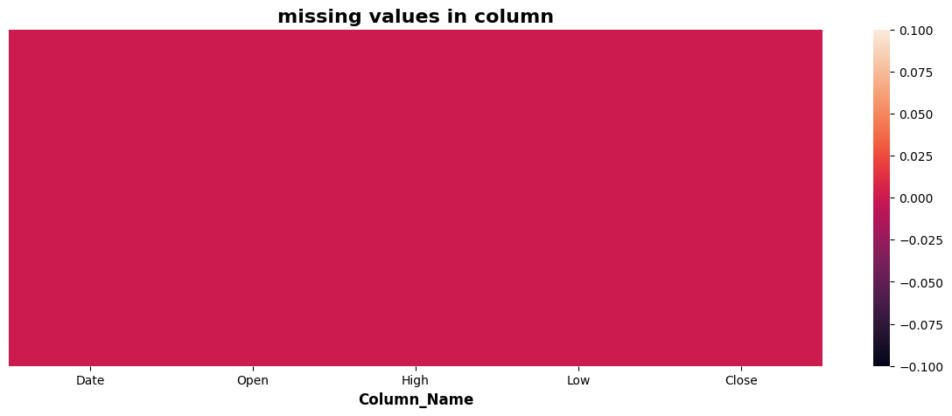
EDA
We can see there is no null values in the given data set.

Slide 11
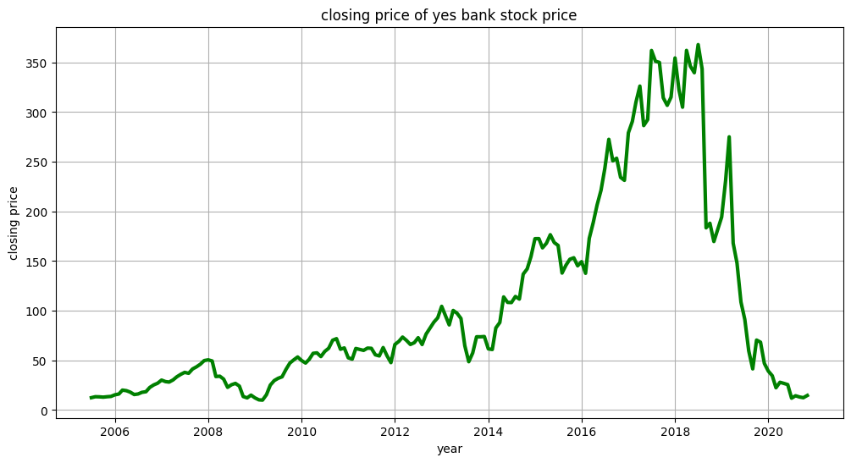
EDA
After 2018 yes bank stock price fall beacuse of fraud case regarding to Rana kapoor.
The Stock's Closing Price on July 2005 and on November 2020 are almost same.
The Stock's Price was on its peak during July 2017 to July 2018.

Slide 12
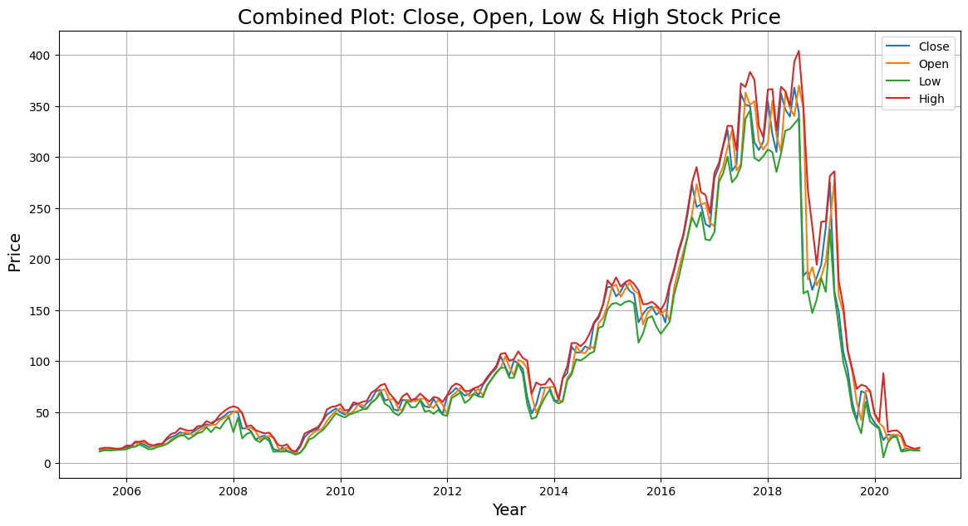
EDA
we can see in 2017 to 2019 there can be high action seen because of difference in high and low lines.
from 2005 to 2014 is a good time to invest in this stock and we can get good hike if we invest

Slide 13
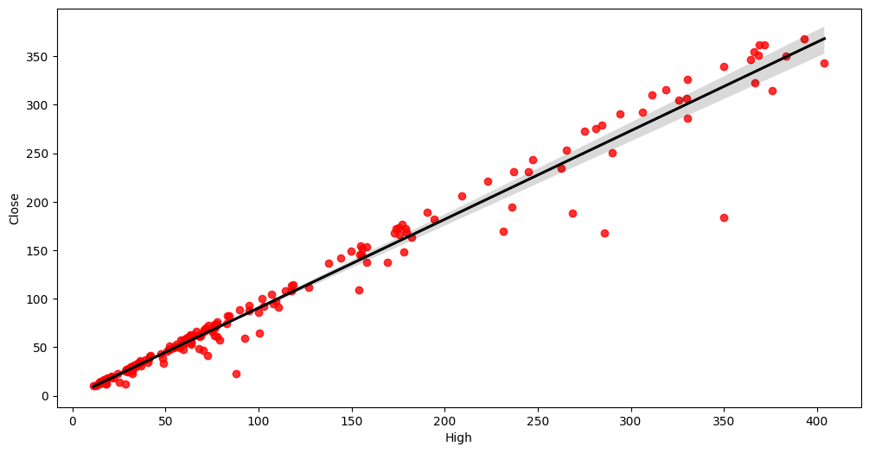
EDA(continue…)
From Regression Plot High Price are Positively Relation to target Variable Close Price.

Slide 14
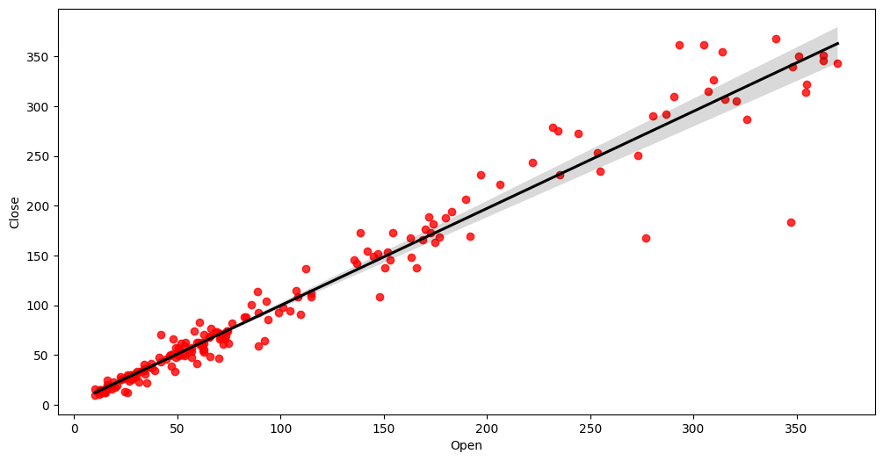
EDA(Continue..)
From Regression Plot Open Price are Positively Relation to target Variable Close Price.

Slide 15
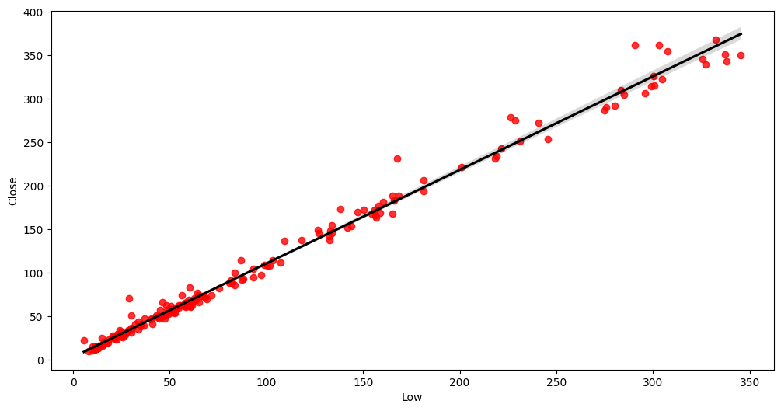
EDA(Continue…)
From Regression Plot Open Price are Positively Relation to target Variable Close Price.

Slide 16
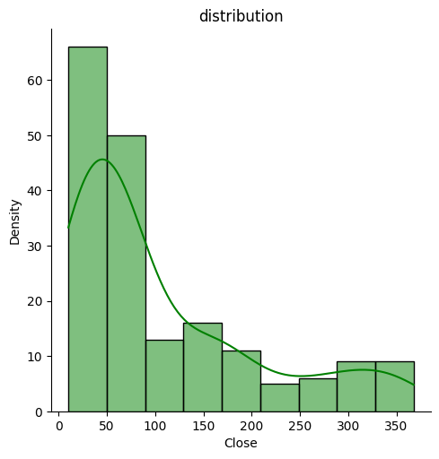
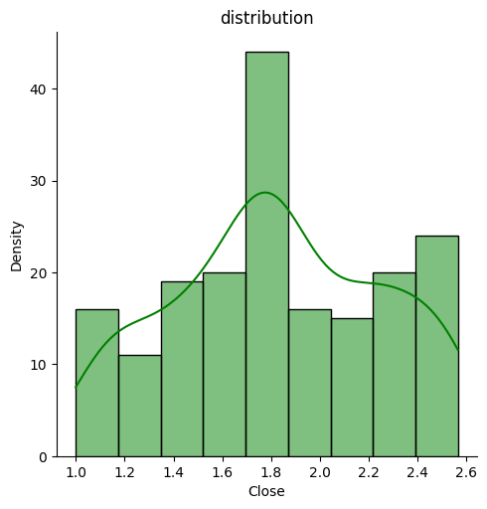
EDA
• Distribution of closing price is right skewed.
• We need this distribution to be normal distribution for training algorithm.

Slide 17
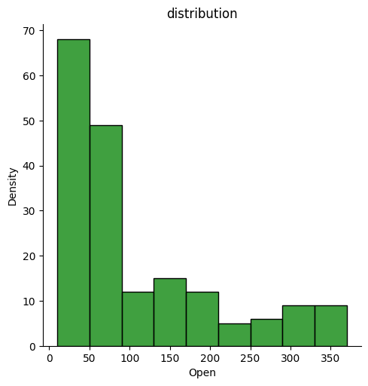
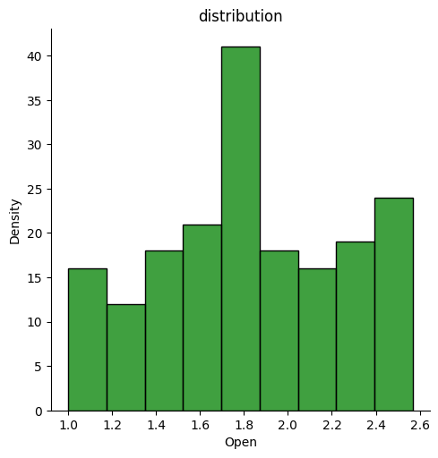
EDA
Distribution of Open Price is Positively Skewed we need to go with log transformation to make it normal distribution.

Slide 18
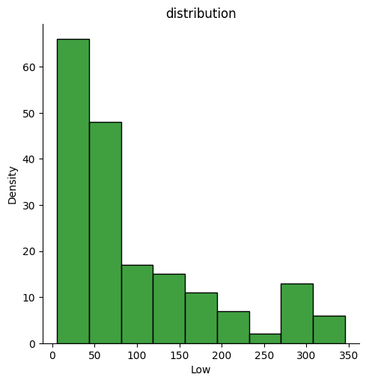
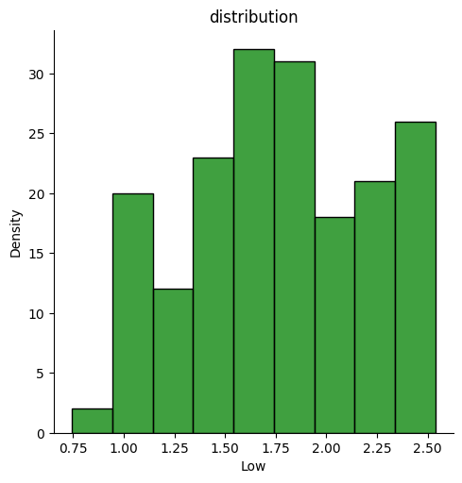
EDA
Distribution of Low Price is Positively Skewed we need to go with log transformation to make it normal distribution.

Slide 19
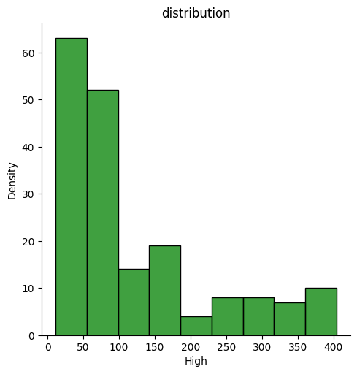
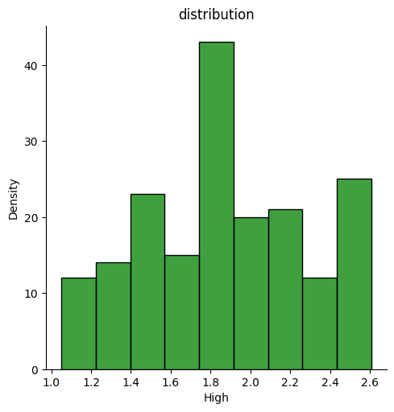
EDA
Distribution of High Price is Positively Skewed we need to go with log transformation to make it normal distribution.

Slide 20
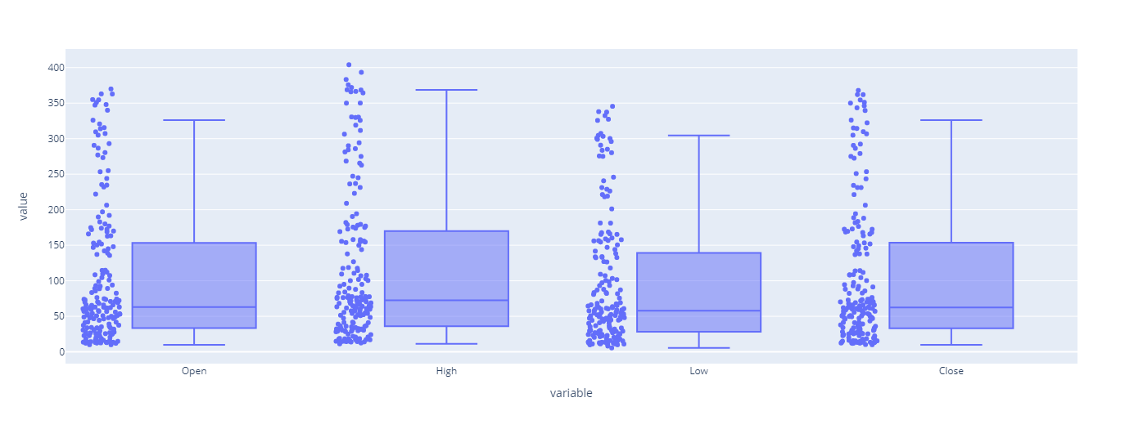
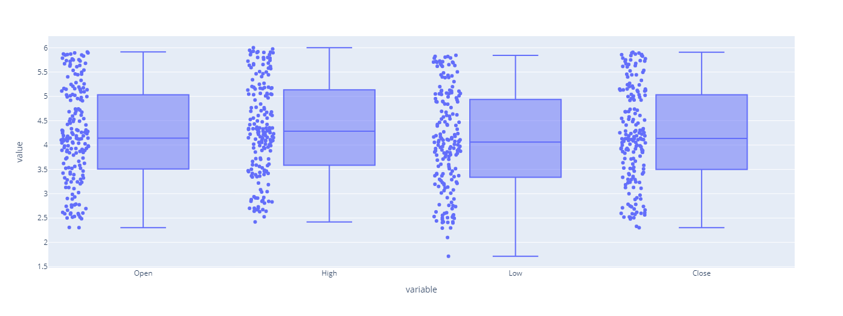
Remove outliers
I have used log transformation technique to handle the outliers . My data was right skewed and log transformation served 2 purpose on the dataset:
Removed Outliers
Normalized the data

Slide 21
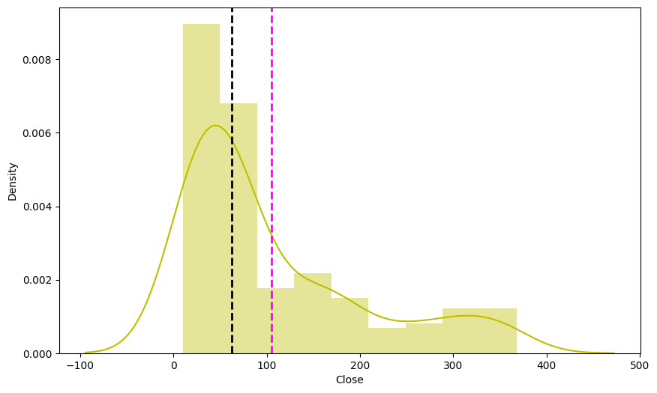
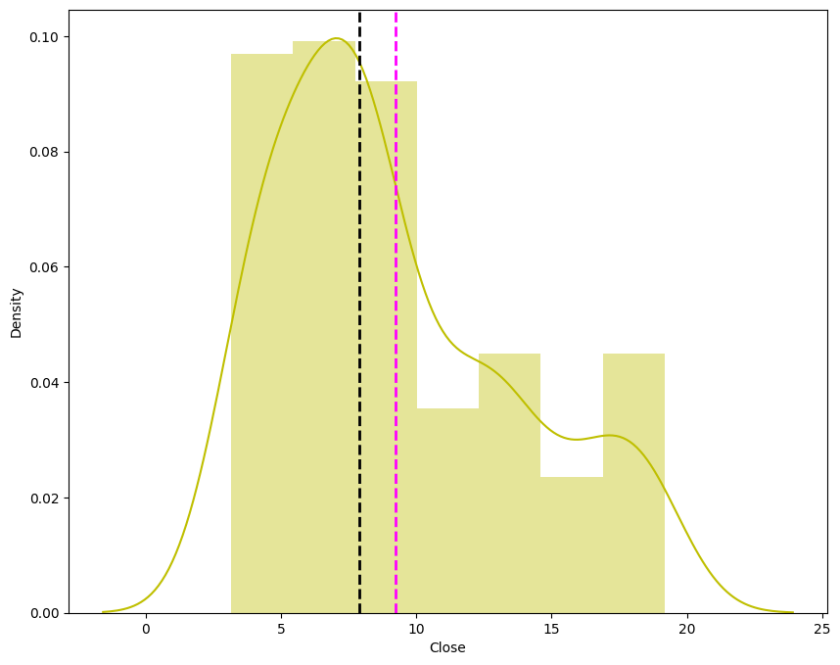
EDA
Closing Price of our features are Positively Skewed so we can apply sqrt,log10 or reciprocal transformation on them to make it normal Distribution.

Slide 22
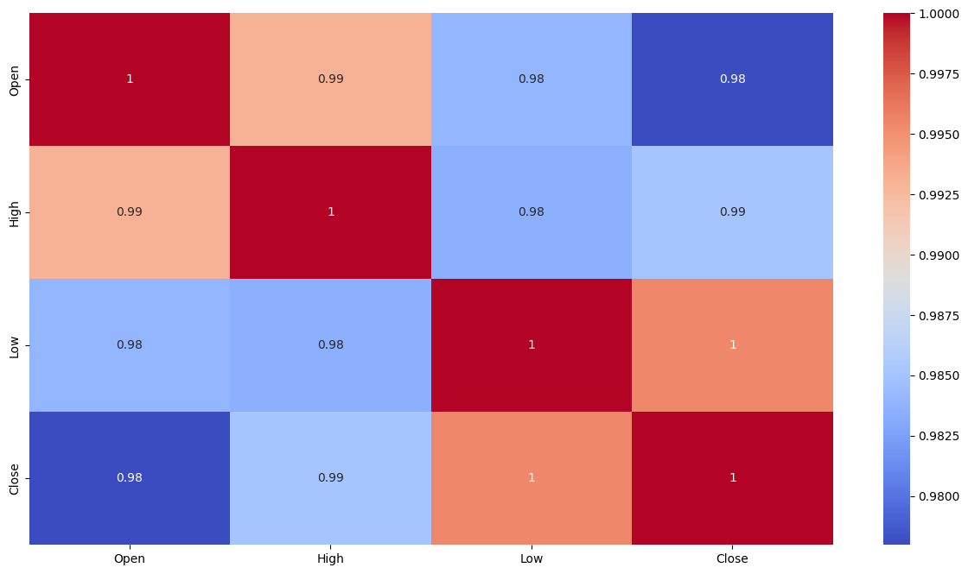
EDA
To check correlation between different variables using Correlation heatmap, it is graphical representation of correlation matrix representing correlation between different variables.
There are very high correlation between independent variables which lead us to multicollinearity. High multicollinearity is not good for fitting model and prediction because a slight change in any independent variable will give very unpredictable results.

Slide 23
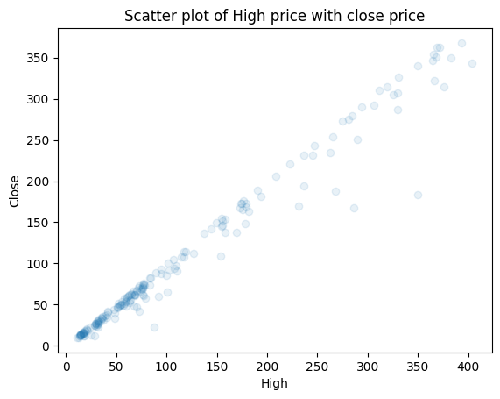
Statistical Analysis
High Price and Closing Price are positively co related .

Slide 24

Statistical Analysis
Low Price and Closing Price are positively co related .

Slide 25
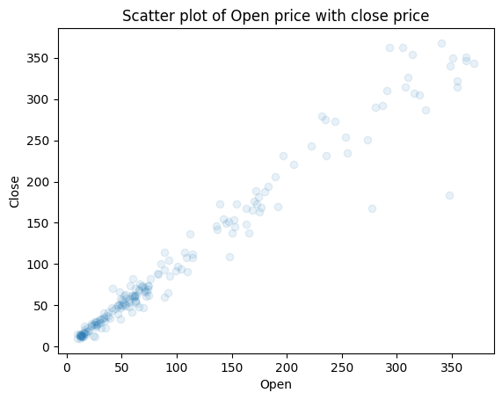
Statistical Analysis
Open Price and Closing Price are positively co related .

Slide 26
Transformation of Data
• To scale data into a uniform format that would allow us to utilize the data in a better way.
• For performing fitting and applying different algorithms to it.
• The basic goal was to enforce a level of consistency or uniformity to dataset.

Slide 27
Splitting data
• Data splits into training dataset and testing dataset.
• Training dataset is for making algorithm learn and train model.
• Test dataset is for testing the performance of train model.
• Here 80% of data taken as training dataset & remaining 20% of dataset used for testing purpose.

Slide 28
Applying ML algorithm
Since we have to predict Closing Price . Hence we have to use regression algorithms.
Algorithms that we will use are:
➢Linear Regression
➢Lasso Regression
➢Ridge Regression
➢Elastic Net Regression

Slide 29
Model implementation
Linear Regression
•Linear regression is one of the easiest and most popular Machine Learning algorithms.
• It is a statistical method that is used for predictive analysis.
•Linear regression algorithm shows a linear relationship between a dependent and independent variable; hence it is called as linear regression.

Slide 30
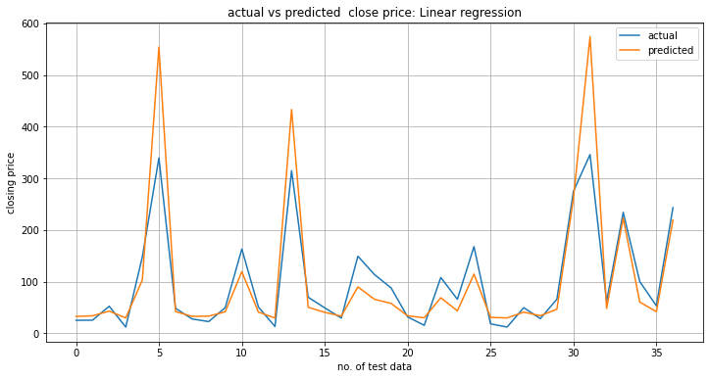
Actual vs predicted close price:Linear regression

Slide 31
Lasso algorithm
Lasso Regression
• Lasso: Least Absolute Shrinkage and Selection operator
• It is a regression analysis method that performs both variable selection and regularization in order to enhance the prediction accuracy and interpretability of the resulting statistical model.
• This method performs L1 regularization.

Slide 32
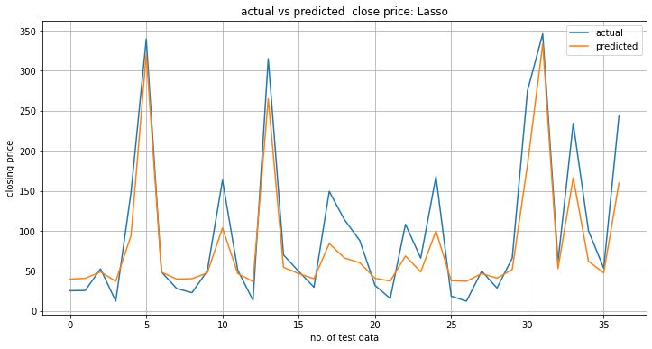
Actual vs predicted close price:Lasso regression

Slide 33
Ridge algorithm
•Ridge regression is a model tuning method that is used to analyses any data
that suffers from Multicollinearity.
•When the issue of multicollinearity occurs, least-squares are unbiased, and
variances are large, this results in predicted values to be far away from the actual
values.
• This method performs L2 regularization.

Slide 34
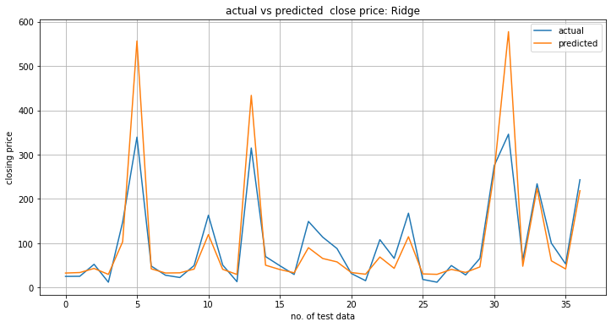
Actual vs predicted close price:Ridge regression

Slide 35
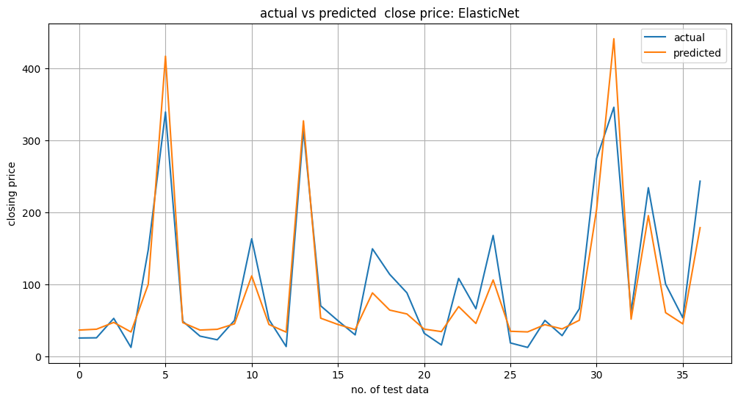
Elasticnet algorithm
Elastic net regression uses the penalties from both the lasso and ridge methods to regularize regression models. This method combines both the lasso and ridge regression methods by learning from their defects to improve the regularization of statistical models.

Slide 36
Evaluation Metrics
Various types of linear model are implemented on data such as Linear regression, Ridge regression, Lasso regression, Elastic net regression.
Model | MSE(Train) | RMSE(Train) | R2((Train) | MSE(Test) | RMSE(Test) | R2(Test)
Linear Regression | 0.034 | 0.183 | 0.815 | 0.032 | 0.178 | 0.823
Ridge | 0.034 | 0.183 | 0.815 | 0.032 | 0.178 | 0.823
Lasso | 0.044 | 0.209 | 0.760 | 0.044 | 0.209 | 0.755
Elastic Net | 0.037 | 0.193 | 0.796 | 0.036 | 0.191 | 0.796

Slide 37
Model validation and selection
•Best results on model is obtained from both Elastic Net regressor and lasso gridsearchcv.
•After implementation of Grid search CV model final accuracy (r2) for Elastic Net and lasso gridsearchcv was more.
Model | MSE(Train) | RMSE(Train) | R2(Train) | MSE(Test) | RMSE(Test) | R2(Test)
ElasticNet gridsearch CV | 0.034 | 0.184 | 0.814 | 0.032 | 0.180 | 0.819
Lasso gridsearch CV | 0.033 | 0.183 | 0.814 | 0.032 | 0.179 | 0.819

Slide 38
Conclusion
During the time of our analysis, we initially did Elimentary data analysis(EDA) on all the features of our datset. We first analysed our dependent variable, 'Close' and also transformed it.
Next we implemented 4 machine learning algorithms Linear Regression, lasso, ridge,elasticnet. We did hyperparameter tuning to improve our model performance. The results of our evaluation are:
No overfitting is seen
Linear Regression and lasso Regression are almost same R2 Score 82%.

Slide 39
Conclusion
Random forest Regressor and ElasticNet gridsearchcv gives the highest R2 score of 99% and 81% recpectively for Train Set and 82% for Test set.
Lasso Regression Show Less R2 Score.
Target variable(dependent variable) strongly dependent on independent variables

Slide 40
THANK YOU

